Slide 1

Data Privacy and Protection Culture in the Era of Emerging Technologies:
Governance, Trust and Accountability under GAID

Slide 2
Outline
What is Data Privacy?
What is Data Protection?
Data Privacy and Protection Culture
Emerging Technologies
Brief Overview of NDPR and NDPA
NDPA General Application and Implementation Directive (GAID)
Key Highlights of GAID 2025
Definition of Terms.
Privacy by Design
Privacy Governance
ISO 27701 Privacy Information Management System (PIMS) Integration
Data Privacy Impact Assessment (DPIA)
Conclusion

Slide 3

Data Privacy
What is Data Privacy?
  Data privacy is a guideline for how data should be collected or handled, based on its sensitivity and importance.
  Data privacy concerns apply to all sensitive information that organizations handle, including that of customers, shareholders, and employees.
  Example:
    User Consent Mechanism: An online retailer always gets users’ explicit consent before sharing customer data with its partners.
    Data Anonymization in healthcare

Slide 4
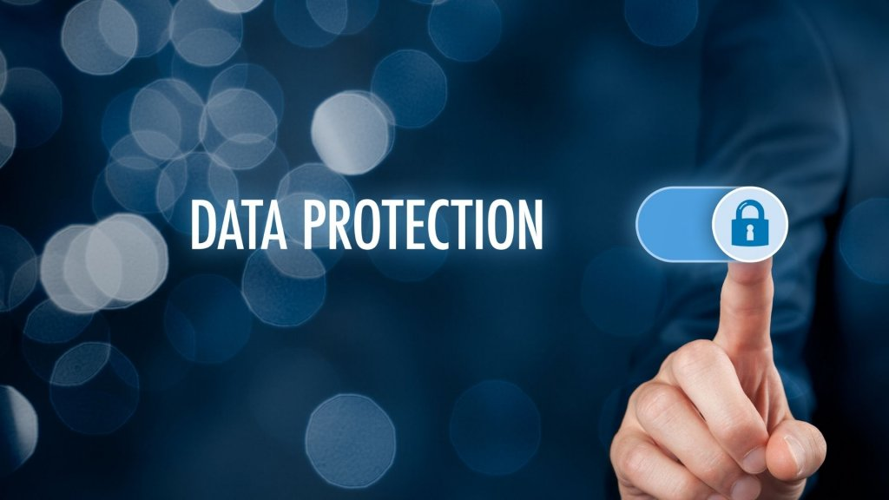
Data Protection
What is Data Protection?
  Data protection signifies the strategic and procedural steps undertaken to safeguard the privacy, availability, and integrity of sensitive data.
  The primary goal of data protection is not just to safeguard sensitive information but to ensure that it remains accessible and reliable, thus preserving trust and compliance in data-centric operations.
  Examples:
    Data Security, Access Controls, Storage requirements

Slide 5
Data Privacy and Protection Culture
A data privacy and protection culture is the collective mindset, shared values, and daily behaviors within an organization that prioritize the ethical handling, security, and confidentiality of personal data.
It transforms data protection from a legal checkbox into a proactive, ingrained responsibility, ensuring that employees naturally respect privacy rights and secure data, even when unsupervised.
Few Components of Data Privacy and Protection Culture:
  Shared Responsibility
  Proactive Mindset
  Ethical Handling
  Accountability and Trust

Slide 6

Emerging Technology
Emerging technology is a term generally used to describe a new technology, but it may also refer to the continuing development of an existing technology.
They have the potential to significantly change the way we live, work and interact with the world around us.
Examples of Emerging Technologies:
  Artificial Intelligence
  Internet of Things (IoT)
  Blockchain
  Virtual Reality and Augmented Reality.

Slide 7

Brief Overview of NDPR and NDPA
Nigeria Data Protection Regulations (NDPR) was the principal law on data protection in Nigeria.
NDPR was issued in 2019 by the National Information Technology Development Agency (NITDA).
The Nigeria Data Protection Act (NDPA) 2023, signed into law on June 12, 2023, establishes a comprehensive legal framework for data protection, replacing the 2019 Nigeria Data Protection Regulation (NDPR).
It mandates the creation of the Nigeria Data Protection Commission (NDPC) to regulate data processing and enforce compliance.

Slide 8

NDPA General Application and Implementation Directive (GAID)
On Thursday, 20 March 2025, the Nigeria Data Protection Commission (the “Commission”) issued the Nigeria Data Protection Act – General Application and Implementation Directive (“GAID”) pursuant to its powers under the Nigeria Data Protection Act 2023 (“NDPA”).
The GAID seeks to enhance the understanding, implementation and effectiveness of the NDPA and is divided into 52 Articles and 10 Schedules.
By virtue of Article 3(3) of the GAID, the Nigeria Data Protection Regulation (NDPR) 2019 (and consequently the NDPR Implementation Framework 2020 ) will cease to be operational as data protection regulation.
All acts carried out during their subsistence, however, will remain valid.

Slide 9
General Compliance of GAID 2025
Compliance Measures by Data Controllers and Data Processors (DCs/DPs):
  twenty-three (23) key measures to be undertaken by DCs/DPs
  registration as a DC/DP of major importance (“DCPMIs”);
  conduct of annual compliance audit by DCPMIs of Ultra-High Level and Extra-High Level before the 31st of March each year;
  maintenance of semi-annual data protection reports which are to contain an analysis of data processing within six (6) months;
  Appointment of Data Protection Officer (DPO).
Compliance Audit Returns
Assessment on the Reliance on Each Basis of Legal Processing
Introduction of the Data Subjects’ Notice to Address Grievance (“SNAG”)

Slide 10
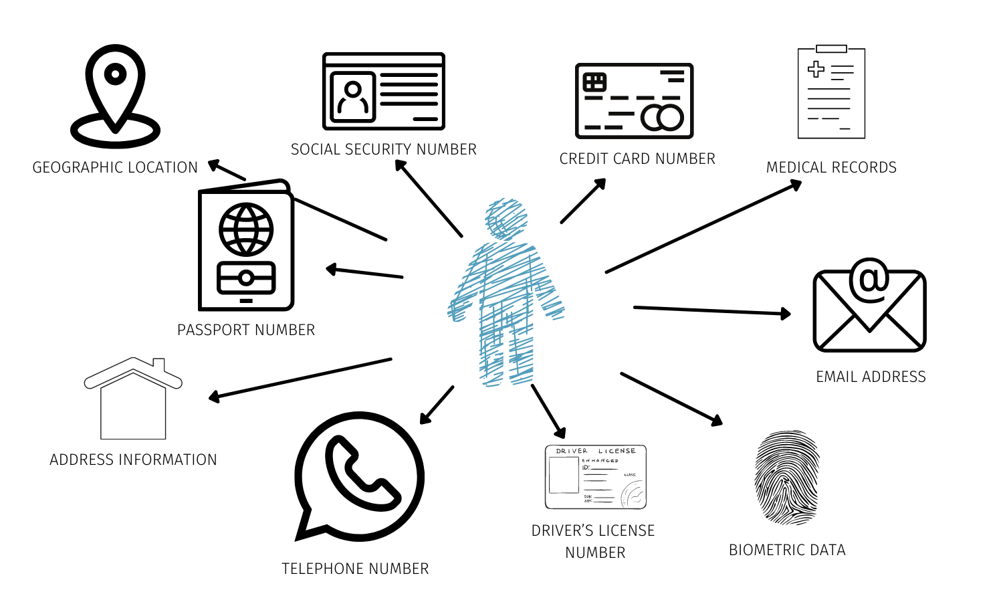
Definition of Terms
Data Subject: Data Subject' is defined as an identifiable natural person whose personal data is being collected, held or processed. (e.g., An energy customer with a smart meter; an employee at a refinery).
Personal Data: Personal data is any information that relates to an identified or identifiable living individual (data subject).
PII (Personally Identifiable Information): Specific identifiers that can distinguish an individual (NIN, BVN, Biometrics).

Slide 11

Definition of Terms
Data Controllers:
  Determines the “Why” and “How”.
  Data ‘controller’ means the natural or legal person, public authority, agency or other body which, alone or jointly with others, determines the purposes and means of the processing of personal data.
  Example; an energy data collecting billing data.
Data Processors:
  Acts on behalf of the controller.
  Data ‘processor’ means a natural or legal person, public authority, agency or other body which processes personal data on behalf of the controller.
  Example; a SaaS company managing the billing software.

Slide 12
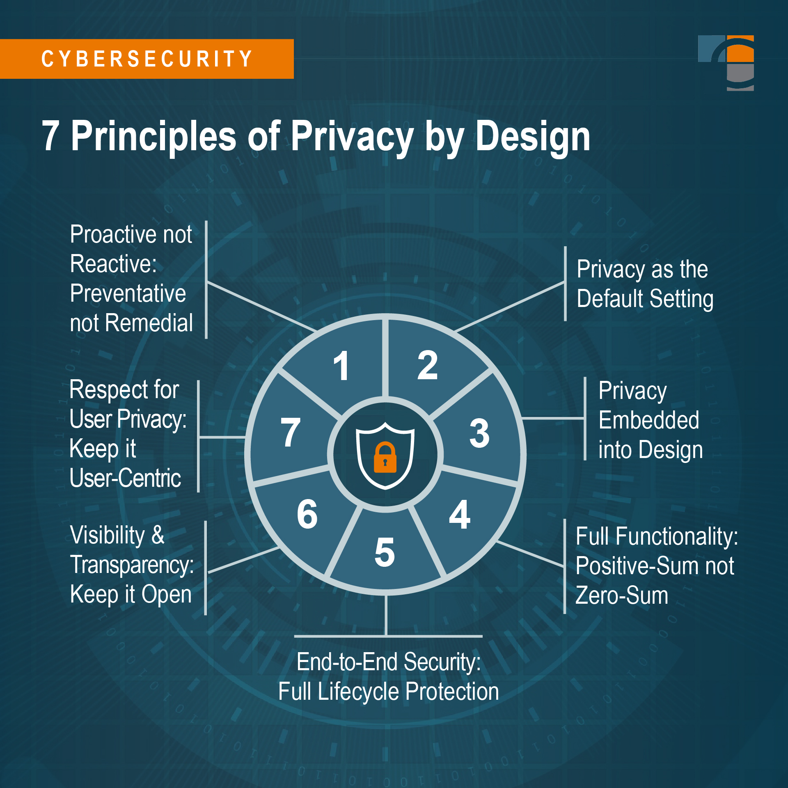
Privacy by Design
Privacy by Design: is a proactive framework developed by Dr. Ann Cavoukian that integrates data protection into the architecture of technologies from the outset, rather than as an afterthought.
Privacy by Design means nothing more than “data protection through technology design.” Behind this is the thought that data protection in data processing procedures is best adhered to when it is already integrated in the technology when created.

Slide 13
Privacy Governance
Privacy governance is a structured set of guidelines, principles, policies, and processes that a business establishes to ensure that personal data (both customer and employee) is properly handled and protected.
Governance is also a matter of ethics.
Core features of Governance Include:
  An appointed person who is responsible for accountability and oversight; e.g., a data protection officer (DPO) or privacy program manager
  A policy framework
  A policy framework
  Data subject rights management
  Legal and regulatory compliance with appropriate laws
  Training and awareness

Slide 14

ISO 27701 Privacy Information Management System (PIMS) Integration
What is ISO/IEC 27701?
  International Standard for Privacy Information Management System (PIMS).
  A Privacy extension to ISO/IEC 27001 Information Security Management System and ISO/IEC 27002 Security Controls.
  Provides guidance and requirements on the protection of privacy, helping both personally identifiable information (PII) processors and controllers to put robust data processes and controls in place.
  The standard can provide the data privacy and information security standards required by General Data Protection Regulation (GDPR).

Slide 15
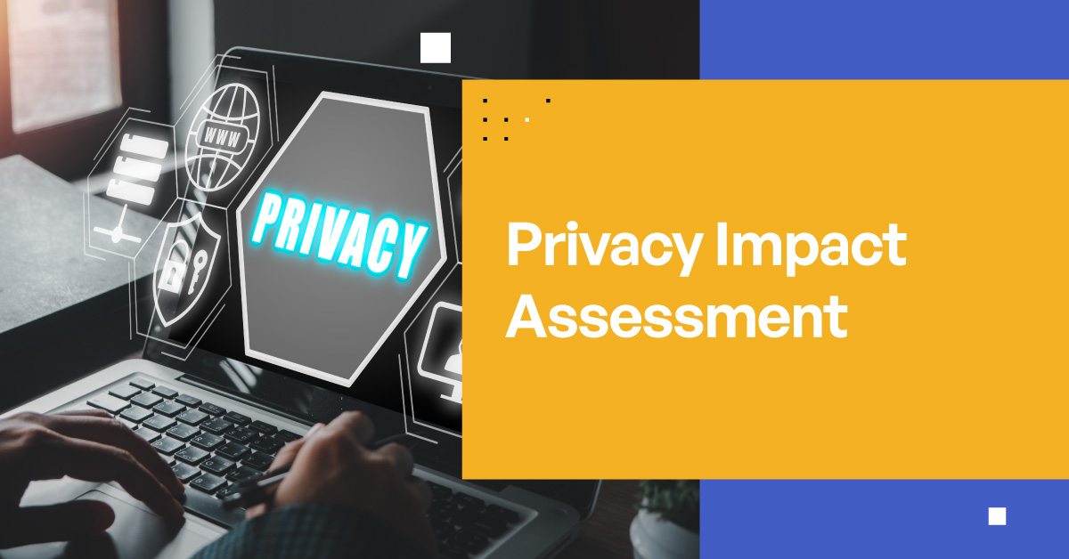
Data Privacy Impact Assessment.
Data Protection Impact Assessment (DPIA) describes a process designed to identify risks arising out of the processing of personal data and to minimize these risks as far and as early as possible.
This assessment is particularly crucial in ensuring compliance with data protection regulations.
Aim of DPIA include:
  Identify and minimize data protection risks in data processing activities.
  Ensure compliance with privacy regulations such as GDPR, NDPA GAID.

Slide 16

Conclusion
GAID operationalizes the NDPA with precisions and authority for organizations, the obligations are unambiguous:
  Register, classify, appoint DPOs, conduct audits, file returns, maintain records, protect rights, notify breaches, regulate transfers & train staffs.
GAID 2025 transforms data protection from a compliance afterthought into a pillar of corporate governance.
Businesses that embrace this transformation will not only avoid penalties but also build trust, attract investment, and thrive in Nigeria’s evolving digital economy.

